Slide 1
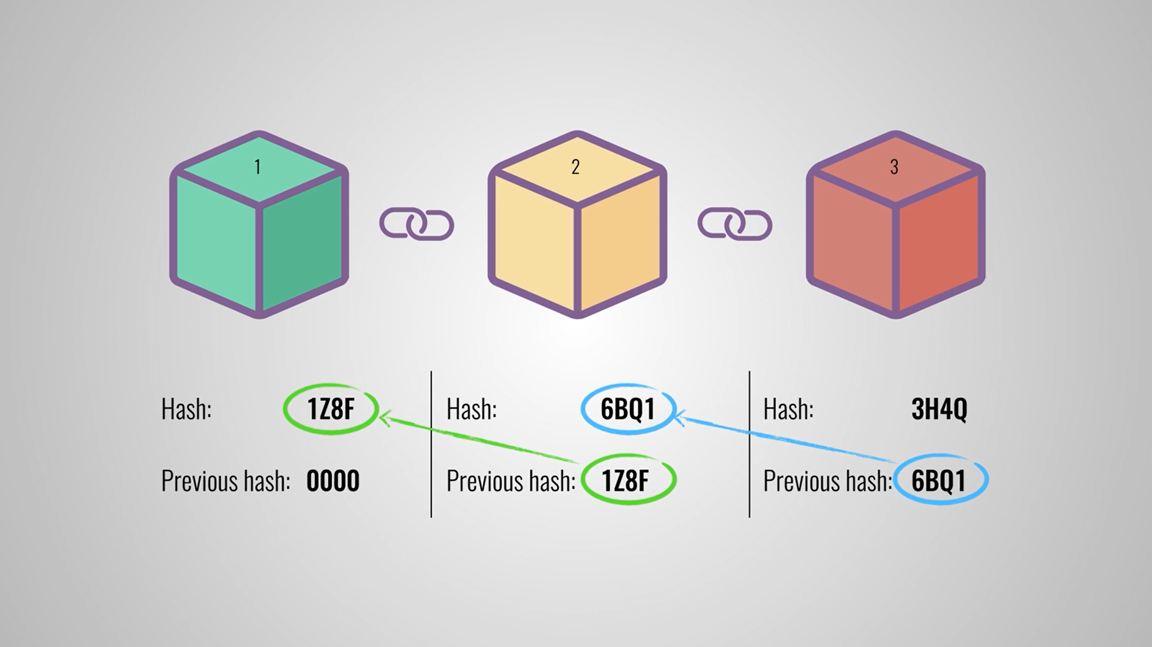
SIRT Bhopal
Session 22-23
IT Department
Minor Project - Peer To Peer Carpooling
Team Name - Undefined
Members are-
Prashant [036] Shaziya [049] Yash [062] Rohit [041]

Slide 2
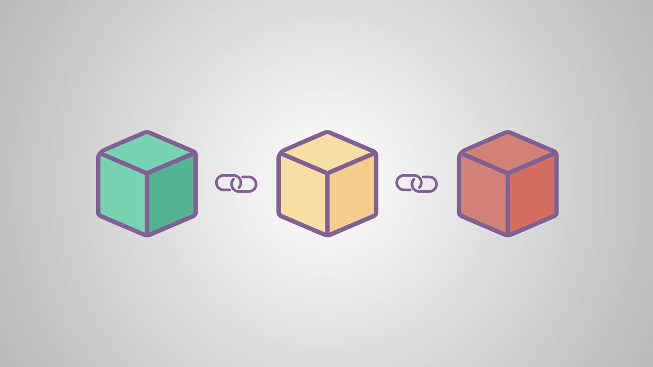



What is blockchain ?

Slide 3
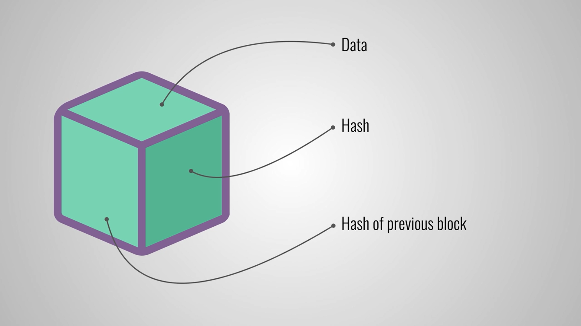
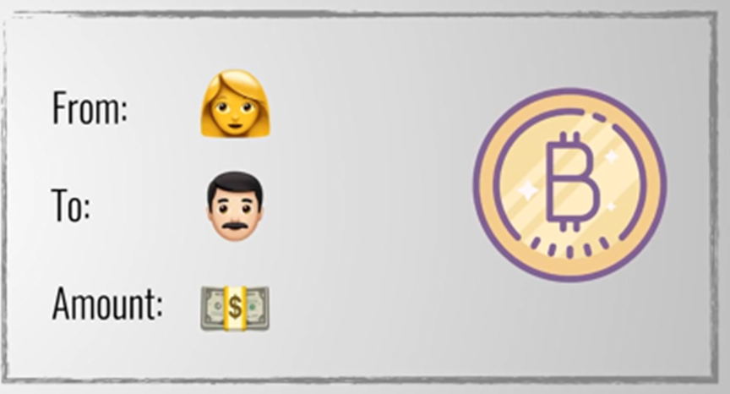


Slide 4

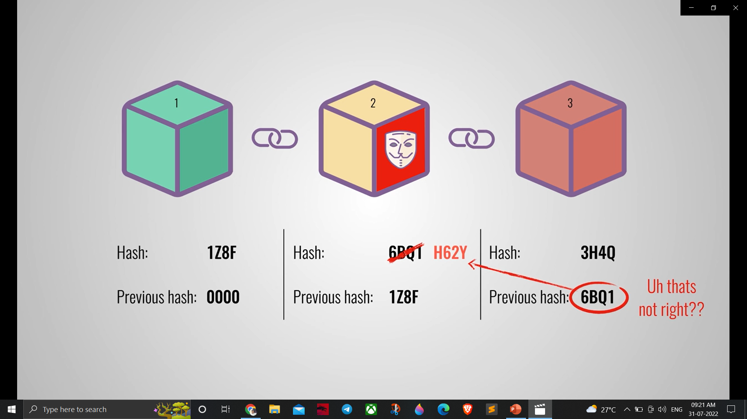

Slide 5
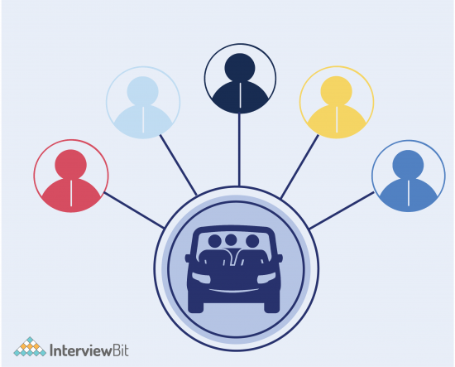
Peer To Peer Carpooling
The project idea is a peer-to-peer carpooling application. Currently, most carpooling systems are in the control of one agency. We can create a smart contract that would connect the rider and driver directly without the intervention of any third party like Uber or Ola. Agencies like Uber and Ola have all the data of drivers as well as of riders and this can lead to major privacy issues. If somehow, ride-sharing and car hire are moved to blockchain then we can build a much more secure and reliable carpooling system.

Slide 6
Why ??
Reduced Traffic– Reduced number of vehicles means less traffic on the road and people will reach their destinations on time. Sitting in traffic for long hours make individuals irritated and bored. Most importantly, it delays the arrival at the destination. Lesser cars mean less traffic.
Allows saving– Carpooling is an excellent way to save money and time. One can save money from the costs of travelling, including the fuels of cars. Time will also be saved, as there will be less traffic.
Carpooling is convenient
Carpooling provides commuting convenience comparable to driving alone, with less stress and with the added bonus of companionship while you’re commuting. Carpooling partners establish their own unique rules that best meet the needs of their carpool.
Carpooling will save YOU money
Carpooling allows you to share the cost of gas and parking, cutting your expenses by nearly 50% or more; the more occupants in your carpool the more you save. Carpooling is also socially economical. Not only will you be saving, but you will also help reduce the costs we all pay towards the construction of new roads, road maintenance and air pollution related health costs.
Carpooling is better for the environment
It’s good for your health
According to Environment Canada, air pollution caused by vehicular travel is linked to a number of health concerns including respiratory diseases, cardiovascular disease, allergies and neurological effects.
Different time requirements- Individuals who carpool together may finish works at different times or may need to reach their destination differently. It becomes a problem when carpooling.
Make new friends
Carpooling is a great way to make new friends!

Slide 7
Tech Stack

Slide 8
Thank You

